Slide 1
The Costs of Production
HS201
Copyright © 2004 McGraw-Hill Australia Pty Ltd
PPTs t/a Microeconomics 7/e by Jackson and McIver
Slides prepared by Muni Perumal, University of Canberra, Australia.

Slide 2
Learning Objectives
Distinguish between the economic short run and the economic long run.
Understand the relationship between the marginal product of labour and the average product of labour.
Explain and illustrate the relationship between marginal cost and average total cost.
Graph average total cost, average variable cost, average fixed cost, and marginal cost.
Understand how firms use the long-run average cost curve to plan.

Slide 3
Economics Costs
Opportunity cost: The highest-valued alternative that must be given up to engage in an activity.
Explicit costs A cost that involves spending money. Explicit costs require outlays of money. For example, wages paid to employees, rent payments, and utility bills are all explicit costs.
Implicit costs A non-monetary opportunity cost. For example, the time and effort that an owner puts into the maintenance of the company, rather than working on expansion, can be viewed as an implicit cost of running the business.
Normal profit is a cost, the minimum payment to retain factors of production by a firm, a fixed cost?
Copyright © 2004 McGraw-Hill Australia Pty Ltd
PPTs t/a Microeconomics 7/e by Jackson and McIver
Slides prepared by Muni Perumal, University of Canberra, Australia.

Slide 4
Short and Long Run
Variable Costs
  Factors of production whose quantity can be increased or decreased during a particular period
Fixed Costs
  Factors of production whose quantity cannot be increased or decreased during a particular period
Copyright © 2004 McGraw-Hill Australia Pty Ltd
PPTs t/a Microeconomics 7/e by Jackson and McIver
Slides prepared by Muni Perumal, University of Canberra, Australia.

Slide 5
Short and Long Run (cont.)
Short run
  a period of time where at least one factor is fixed, usually capital stock is fixed, and all others are variable.
Long run
  a time period where all factors of production, even the capital stock, can be varied
  How long is the short run? The time required for a firm to alter its capital stock. This will vary depending on the nature of the firm
Copyright © 2004 McGraw-Hill Australia Pty Ltd
PPTs t/a Microeconomics 7/e by Jackson and McIver
Slides prepared by Muni Perumal, University of Canberra, Australia.

Slide 6
Short-Run Production Costs
Law of Diminishing Returns
  as successive units of a variable resource (say, labour) are added to a fixed resource (say, capital) beyond some point the extra, or marginal product attributable to each additional unit of the variable resource will decline
  Hence, the SR supply curve will be upward sloping for firms and the industry
Copyright © 2004 McGraw-Hill Australia Pty Ltd
PPTs t/a Microeconomics 7/e by Jackson and McIver
Slides prepared by Muni Perumal, University of Canberra, Australia.

Slide 7
Inputs of
the
variable
resource
Extra or
marginal
product
Total
product
Average
product
0
1
2
3
4
5
6
7
8
9
0
10
25
37
47
55
60
63
63
62
]
10
15
12
10
8
5
3
0
–1
10.0
12.5
12.3
11.8
11.0
10.0
9.0
7.9
6.9
]
]
]
]
]
]
]
]
Copyright © 2004 McGraw-Hill Australia Pty Ltd
PPTs t/a Microeconomics 7/e by Jackson and McIver
Slides prepared by Muni Perumal, University of Canberra, Australia.

Slide 8
Short-Run Production Costs
Marginal Product (MP)
  additional output resulting from the addition of an extra unit of a resource
Average Product (AP)
  the total output per unit of resource employed
  total product divided by number of workers
Total Product (TP)
  the total output of a good produced by a firm
Copyright © 2004 McGraw-Hill Australia Pty Ltd
PPTs t/a Microeconomics 7/e by Jackson and McIver
Slides prepared by Muni Perumal, University of Canberra, Australia.

Slide 9
Law of Diminishing Returns
Total Output
Total Product, TP
Quantity of Labour
Average
Product
Average Product, AP, and
Marginal Product, MP
Marginal
Product
Quantity of Labour
Copyright © 2004 McGraw-Hill Australia Pty Ltd
PPTs t/a Microeconomics 7/e by Jackson and McIver
Slides prepared by Muni Perumal, University of Canberra, Australia.

Slide 10
Fixed, Variable & Total Costs
Fixed costs
  do not vary with changes in output
Variable costs
  vary with changes in output
Total costs
  the sum of fixed and variable costs at each level of output
Copyright © 2004 McGraw-Hill Australia Pty Ltd
PPTs t/a Microeconomics 7/e by Jackson and McIver
Slides prepared by Muni Perumal, University of Canberra, Australia.

Slide 11



Total Costs
TC
TVC
Fixed Cost
Costs (dollars)
Total
Cost
Variable Cost
TFC
Quantity
Copyright © 2004 McGraw-Hill Australia Pty Ltd
PPTs t/a Microeconomics 7/e by Jackson and McIver
Slides prepared by Muni Perumal, University of Canberra, Australia.

Slide 12
Marginal Costs
Marginal Cost (MC)
  the extra, or additional cost of producing one more unit of output
Change in Total Costs
Marginal Cost =
Change in Quantity
Copyright © 2004 McGraw-Hill Australia Pty Ltd
PPTs t/a Microeconomics 7/e by Jackson and McIver
Slides prepared by Muni Perumal, University of Canberra, Australia.

Slide 13
Marginal Costs
MC
ATC
AVC
Short-run average costs (dollars)
AFC
Quantity
Copyright © 2004 McGraw-Hill Australia Pty Ltd
PPTs t/a Microeconomics 7/e by Jackson and McIver
Slides prepared by Muni Perumal, University of Canberra, Australia.
The distance between ATC and AVC is AFC so these two curves should converge.

Slide 14
Marginal Costs & Marginal Products
Given the price of the variable resource, increasing returns (marginal product) will be reflected in a declining marginal cost, and diminishing returns (marginal product) in a rising marginal cost.
Marginal costs are driven by variable and not fixed costs.
Marginal costs curve is the supply curve, which is discussed in the next topic.
Copyright © 2004 McGraw-Hill Australia Pty Ltd
PPTs t/a Microeconomics 7/e by Jackson and McIver
Slides prepared by Muni Perumal, University of Canberra, Australia.

Slide 15
ADVERTISING
Advertising is used by firms to change tastes and preferences and so increase demand, and may be P and Q and hence TR.
Fixed or variable costs
Copyright © 2004 McGraw-Hill Australia Pty Ltd
PPTs t/a Microeconomics 7/e by Jackson and McIver
Slides prepared by Muni Perumal, University of Canberra, Australia.

Slide 16

QANTAS
The focus of Qantas adverting seems to be brand promotion rather then encouraging sales.
See for example the huge sums of money spent on sponsor ship, eg the Qantas Wallabies, the Australian girls’ choir etc.
So, advertising tends to be a fixed cost.
Copyright © 2004 McGraw-Hill Australia Pty Ltd
PPTs t/a Microeconomics 7/e by Jackson and McIver
Slides prepared by Muni Perumal, University of Canberra, Australia.

Slide 17

VIRGIN
The focus of Virgin adverts seems to be putting bums on seats.
So, extra adverting tends to increase sales.
So, adverting tends to be a variable cost.
Copyright © 2004 McGraw-Hill Australia Pty Ltd
PPTs t/a Microeconomics 7/e by Jackson and McIver
Slides prepared by Muni Perumal, University of Canberra, Australia.

Slide 18
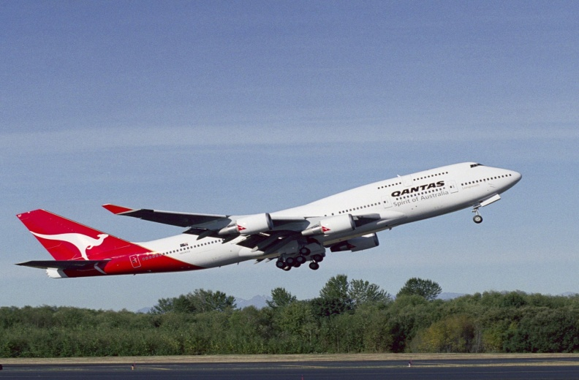
PLANE OWNERSHIP
Fixed or variable costs?
Until recently Qantas has owned all of its planes.
So, are planes a fixed cost?

Slide 19
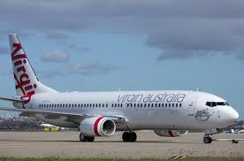
PLANE OWNERSHIP
Fixed or variable costs.
Virgin does not own any of its planes.
So, are planes a variable cost?

Slide 20
Marginal Cost Relationships
When MC > ATC
  ATC increases
When MC < AC
  ATC falls
When ATC = MC
  ATC is at its minimum
Copyright © 2004 McGraw-Hill Australia Pty Ltd
PPTs t/a Microeconomics 7/e by Jackson and McIver
Slides prepared by Muni Perumal, University of Canberra, Australia.

Slide 21
Long-Run Production Costs
All factors variable
  all costs are variable
Long-run cost curve
  shape depends on economies of scale
  scale is defined as different levels of plant utilisation
Copyright © 2004 McGraw-Hill Australia Pty Ltd
PPTs t/a Microeconomics 7/e by Jackson and McIver
Slides prepared by Muni Perumal, University of Canberra, Australia.

Slide 22
Long-Run Production Costs (cont.)
For every plant capacity size...
there is a short-run ATC curve,
and every ATC has a minimum cost
Unit Costs
Output
Copyright © 2004 McGraw-Hill Australia Pty Ltd
PPTs t/a Microeconomics 7/e by Jackson and McIver
Slides prepared by Muni Perumal, University of Canberra, Australia.

Slide 23
Long-Run Production Costs
An infinite number of such
cost curves can be constructed
Unit Costs
Output
Copyright © 2004 McGraw-Hill Australia Pty Ltd
PPTs t/a Microeconomics 7/e by Jackson and McIver
Slides prepared by Muni Perumal, University of Canberra, Australia.

Slide 24
Long-Run Production Costs
The long-run ATC just
‘envelops’ all the short-run ATC
curves
Unit Costs
Output
Copyright © 2004 McGraw-Hill Australia Pty Ltd
PPTs t/a Microeconomics 7/e by Jackson and McIver
Slides prepared by Muni Perumal, University of Canberra, Australia.

Slide 25
Long-Run Production Costs
Long-run ATC
Unit Costs
Output
Copyright © 2004 McGraw-Hill Australia Pty Ltd
PPTs t/a Microeconomics 7/e by Jackson and McIver
Slides prepared by Muni Perumal, University of Canberra, Australia.

Slide 26
Economies and Diseconomies of Scale
Internal economies of scale- Internal economies of scale are firm specific.
External economies of scale- External economies of scale occur due to large changes outside of a firm that usually impact an entire industry.
Economies of scale-a proportionate saving in costs gained by an increased level of production.“ Mergers may lead to economies of scale“
  ATC falls as plant size increases
Diseconomies of scale
  ATC increases as plant size increases
Constant returns of scale
  ATC constant as plant size increases
Copyright © 2004 McGraw-Hill Australia Pty Ltd
PPTs t/a Microeconomics 7/e by Jackson and McIver
Slides prepared by Muni Perumal, University of Canberra, Australia.

Slide 27
Long-Run ATC Curves
Economies
of scale
Constant returns
to scale
Diseconomies
of scale
Long-run ATC
Unit Costs
Output
Copyright © 2004 McGraw-Hill Australia Pty Ltd
PPTs t/a Microeconomics 7/e by Jackson and McIver
Slides prepared by Muni Perumal, University of Canberra, Australia.

Slide 28
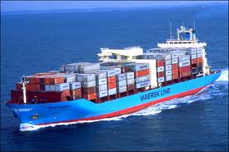
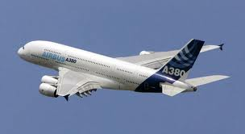
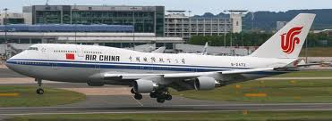
Economies and Diseconomies of Scale
Internal economies of scale arise from:
  Labour specialisation
  Managerial specialisation
  Efficient use of capital
  By-products
A good example is a car factory
http://www.youtube.com/watch?v=S4KrIMZpwCY

Slide 29
Economies and Diseconomies of Scale
External economies of scale arise from the development of networks and clusters, which increase productivity and lower costs by making better use of infrastructure or knowledge
Also know as agglomeration economies
A good example is the network of component firms that surround a car factory.
Copyright © 2004 McGraw-Hill Australia Pty Ltd
PPTs t/a Microeconomics 7/e by Jackson and McIver
Slides prepared by Muni Perumal, University of Canberra, Australia.

Slide 30
Minimum Efficiency Scale
MES is the smallest level of output at which a firm can minimise long-run average costs
Natural monopoly, has a MES that is large than the demand of the industry, so one firm can produce at a lower cost than if two or more firms were in the industry.
Copyright © 2004 McGraw-Hill Australia Pty Ltd
PPTs t/a Microeconomics 7/e by Jackson and McIver
Slides prepared by Muni Perumal, University of Canberra, Australia.

Slide 31
Economies of scope
In economies of scope, firms should take cost advantages by providing a variety of related products to make full use of the inputs rather than specializing in the delivery of a single product.
Sharing or joint utilization of inputs among similar products are the main reason for economies of scale.
Copyright © 2004 McGraw-Hill Australia Pty Ltd
PPTs t/a Microeconomics 7/e by Jackson and McIver
Slides prepared by Muni Perumal, University of Canberra, Australia.

Slide 32
Firm/market diagrams
MC
Copyright © 2004 McGraw-Hill Australia Pty Ltd
PPTs t/a Microeconomics 7/e by Jackson and McIver
Slides prepared by Muni Perumal, University of Canberra, Australia.
Copyright © 2004 McGraw-Hill Australia Pty Ltd
PPTs t/a Microeconomics 7/e by Jackson and McIver
Slides prepared by Muni Perumal, University of Canberra, Australia.

